Slide 1
Fascinating Facts about the Constitution

Slide 2
The U.S. Constitution has 4,400 words. It is the oldest and shortest written Constitution of any major government in the world.

Slide 3
Of the spelling errors in the Constitution, “Pensylvania” above the signers’ names is probably the most glaring.

Slide 4
Thomas Jefferson did not sign the Constitution. He was in France during the Convention, where he served as the U.S. minister. John Adams was serving as the U.S. minister to Great Britain during the Constitutional Convention and did not attend either.

Slide 5
The Constitution was “penned” by Jacob Shallus, A Pennsylvania General Assembly clerk, for $30 ($726 today).

Slide 6
Since 1952, the Constitution has been on display in the National Archives Building in Washington, DC. Currently, all four pages are displayed behind protective glass framed with titanium. To preserve the parchment’s quality, the cases contain argon gas and are kept at 67 degrees Fahrenheit with a relative humidity of 40 percent.

Slide 7
Constitution Day is celebrated on September 17, the anniversary of the day the framers signed the document.

Slide 8
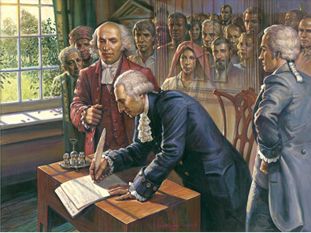

Slide 9
The Constitution does not set forth requirements for the right to vote. As a result, at the outset of the Union, only male property-owners could vote. African Americans were not considered citizens, and women were excluded from the electoral process. Native Americans were not given the right to vote until 1924.

Slide 10
James Madison, “the father of the Constitution,” was the first to arrive in Philadelphia for the Constitutional Convention. He arrived in February, three months before the convention began, bearing the blueprint for the new Constitution.

Slide 11
Of the forty-two delegates who attended most of the meetings, thirty-nine actually signed the Constitution. Edmund Randolph and George Mason of Virginia and Elbridge Gerry of Massachusetts refused to sign due in part due to the lack of a bill of rights.

Slide 12
When it came time for the states to ratify the Constitution, the lack of any bill of rights was the primary sticking point.

Slide 13
The Great Compromise saved the Constitutional Convention, and, probably, the Union. Authored by Connecticut delegate Roger Sherman, it called for proportional representation in the House, and one representative per state in the Senate (this was later changed to two.) The compromise passed 5-to-4, with one state, Massachusetts, “divided.”

Slide 14
Patrick Henry was elected as a delegate to the Constitutional Convention, but declined, because he “smelt a rat.”

Slide 15
Because of his poor health, Benjamin Franklin needed help to sign the Constitution. As he did so, tears streamed down his face.

Slide 16
Gouverneur Morris was largely responsible for the “wording” of the Constitution, although there was a Committee of Style formed in September 1787.

Slide 17
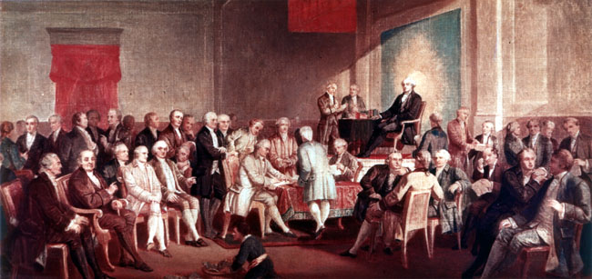

Slide 18
The oldest person to sign the Constitution was Benjamin Franklin (81). The youngest was Jonathan Dayton of New Jersey (26).

Slide 19
When the Constitution was signed, the United States’ population was 4 million. It is now more than 309 million. Philadelphia was the nation’s largest city, with 40,000 inhabitants.

Slide 20
A proclamation by President George Washington and a congressional resolution established the first national Thanksgiving Day on November 26, 1789. The reason for the holiday was to give “thanks” for the new Constitution.

Slide 21
The first time the formal term “The United States of America” was used was in the Declaration of Independence.

Slide 22
It took one hundred days to actually “frame” the Constitution.

Slide 23
There was initially a question as to how to address the President. The Senate proposed that he be addressed as “His Highness the President of the United States of America and Protector of their Liberties.” Both the House of Representatives and the Senate compromised on the use of “President of the United States.”

Slide 24
James Wilson originally proposed the President be chosen by popular vote, but the delegates agreed (after 60 ballots) on a system known as the Electoral College. Although there have been 500 proposed amendments to change it, this “indirect” system of electing the president is still intact.

Slide 25
George Washington and James Madison were the only presidents who signed the Constitution.

Slide 26
In November of 1788 the Congress of the Confederation adjourned and left the United States without a central government until April 1789. That is when the first Congress under the new Constitution convened with its first quorum.

Slide 27
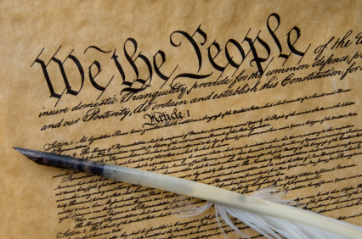

Slide 28
James Madison was the only delegate to attend every meeting. He took detailed notes of the various discussions and debates that took place during the convention. The journal that he kept during the Constitutional Convention was kept secret until after he died. It (along with other papers) was purchased by the government in 1837 at a price of $30,000 (that would be $629,000 today). The journal was published in 1840.

Slide 29
Although Benjamin Franklin’s mind remained active, his body was deteriorating. He was in constant pain because of gout and having a stone in his bladder, and he could barely walk. He would enter the convention hall in a sedan chair carried by four prisoners from the Walnut Street jail in Philadelphia.

Slide 30
As Benjamin Franklin left the Pennsylvania State House after the final meeting of the Constitutional Convention on September 17, 1787, he was approached by the wife of the mayor of Philadelphia. She was curious as to what the new government would be. Franklin replied, “A republic, madam. If you can keep it.”

Slide 31
On March 24, 1788, a popular election was held in Rhode Island to determine the ratification status of the new Constitution. The vote was 237 in favor and 2,945 opposed!

Slide 32
The members of the first Congress of the United States included 54 who were delegates to the Constitutional Convention or delegates to the various state-ratifying conventions. The number also included 7 delegates who opposed ratification.

Slide 33
Benjamin Franklin died on April 17, 1790, at the age of 84. The 20,000 mourners at his funeral on April 21, 1790, constituted the largest public gathering up to that time.

Slide 34
Vermont ratified the Constitution on January 10, 1791, even though it had not yet become a state.

Slide 35
The word “democracy” does not appear once in the Constitution.

Slide 36
There was a proposal at the Constitutional Convention to limit the standing army for the country to 5,000 men. George Washington sarcastically agreed with this proposal as long as a stipulation was added that no invading army could number more than 3,000 troops!

Slide 37
John Adams referred to the Constitution as “the greatest single effort of national deliberation that the world has ever seen” and George Washington wrote to the Marquis de Lafayette that “It (the Constitution) appears to me, then, little short of a miracle.”

Slide 38
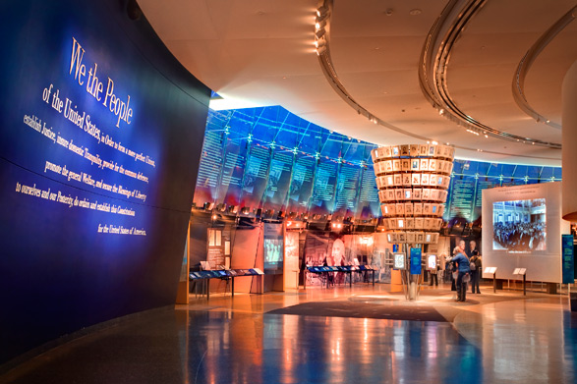

Slide 39
The Pennsylvania State House (where the Constitutional Convention took place) was where George Washington was appointed the commander of the Continental Army in 1775 and where the Declaration of Independence was signed in 1776. It was also where the Articles of Confederation were adopted as our first constitution in 1781.

Slide 40
Rhode Island was the only state not to send delegates to Philadelphia in 1787. At that time the state legislature was controlled by the agrarian party and was fearful that a stronger central government would demand that debts be paid in specie (hard money). It was the last state to ratify the Constitution on May 29, 1790 (over a year after President George Washington’s inauguration) by a vote of 34-32.

Slide 41
The delegates were involved in debates from 10 a.m. until 3 p.m. six days a week with only a 10 day break during the duration of the convention

Slide 42
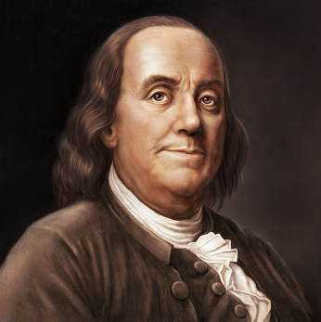

Slide 43
The Constitution contains 4,543 words, including the signatures and has four sheets, 28-3/4 inches by 23-5/8 inches each. It contains 7,591 words including the 27 amendments.

Slide 44
The Constitution was ratified by specially elected conventions beginning in December 1787. The order in which the thirteen states accepted the new constitution was Delaware, Pennsylvania, New Jersey, Georgia, Connecticut, Massachusetts, Maryland, South Carolina, New Hampshire, Virginia, New York, North Carolina and Rhode Island.

Slide 45
Daniel Webster (1782-1852), of Massachusetts, has been called the “Expounder of the Constitution”.

Slide 46
From 1804 to 1865 there were no amendments added to the Constitution until the end of the Civil War when the Thirteenth amendment was added that abolished slavery. This was the longest period in American history in which there were no changes to our Constitution.

Slide 47
The text of the Constitution was printed by John Dunlap and David Claypoole in Philadelphia to then be sent to the various state constitutional conventions for debate and discussion.

Slide 48
As evidence of its continued flexibility, the Constitution has only been changed seventeen times since 1791!

Slide 49
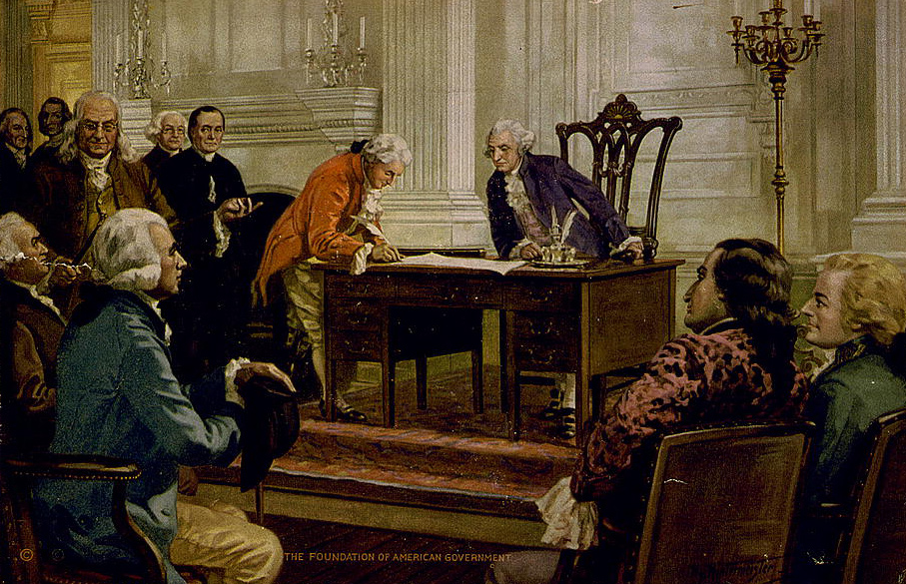

Slide 50
The main reason for the meeting in Philadelphia was to revise the Articles of Confederation. However, the delegates soon concluded that it would be necessary to write an entirely new Constitution. They agreed to conduct the meetings in secrecy by stationing guards at the door to the Pennsylvania state house. When one delegate dropped a convention document, Chairman George Washington replied, “I must entreat the gentlemen to be more careful, lest our transactions get into the newspapers and disturb the public repose.”

Slide 51
At the time of the Constitutional Convention Philadelphia was the most modern city in America and the largest city in North America. It had a population of 40,000 people, 7,000 street lamps, 33 churches, 10 newspapers, and a university.

Slide 52
The median age in America by the end of the 18th century was 16 years of age (today it is around 34 years of age), 19 of every 20 citizens lived on the land, and 70% of the land was worked by its owners (30% by tenants).

Slide 53
The national government spent $4.3 million during the first session of Congress from 1789-1791. During the last year that George Washington was President of the United States (1796-1797), the entire cost of running the federal government was $5,727,000.

Slide 54
The election of George Washington as the first President under the Constitution was not really “unanimous”. In actuality, two electors from Virginia and two electors from Maryland did not vote. New York was entitled to eight electoral votes but the state legislature could not decide how these electors would be chosen, so the state of New York officially did not vote for the President. The electoral vote in 1789 should have totaled 81 but only 69 votes were cast.

Slide 55
James Madison of Virginia was responsible for proposing the resolution to create the various Cabinet positions within the Executive Branch of our government and twelve amendments to the Constitution of which ten became the Bill of Rights.

Slide 56
Although the United States Treasury Department stopped distributing currency denominations of $500, $1,000, $5,000 and $10,000 in 1969, for all intents and purposes the production of each stopped after World War II. However, these notes are still legal tender and may be found on rare occasions in circulation. James Madison, the “Father of the Constitution” is on the $5,000 bill.

Slide 57
At the conclusion of the Constitutional Convention, Benjamin Franklin observed the symbol of a half-sun on George Washington’s chair and remarked, “I have the happiness to know that it is a rising and not a setting sun.”

Slide 58
Benjamin Franklin made a suggestion at the Constitutional Convention that the sessions be opened with a prayer. The delegates refused to accept the motion stating that there was not enough money to hire a chaplain.

Slide 59
Of the fifty-five delegates who attended the convention 34 were lawyers, 8 had signed the Declaration of Independence, and almost half were Revolutionary War veterans. The remaining members were planters, educators, ministers, physicians, financiers, judges and merchants. About a quarter of them were large land owners and all of them held some type of public office (39 were former Congressmen and 8 were present or past governors).

Slide 60
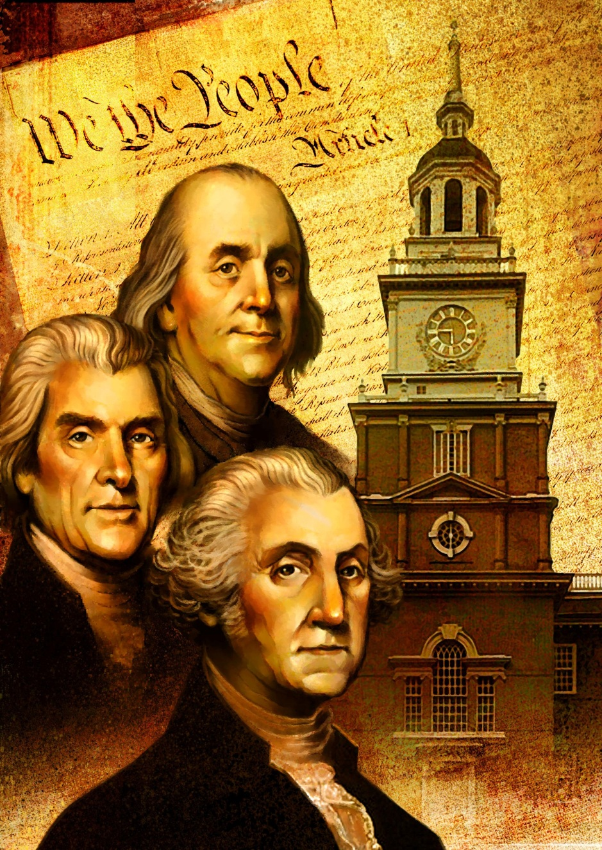

Slide 61
William Few of Georgia was the only member to represent the yeoman farmer class which comprised the majority of the population of the country. Nineteen of the members who were chosen to represent their state never attended a meeting.

Slide 62
Benjamin Franklin of Pennsylvania was known as the “Sage of the Constitutional Convention.” He was also the mediator at the convention and often counseled that “we are here to consult, not to contend”.

Slide 63
George Washington and James Madison were the only Presidents who signed the Constitution.

Slide 64
Elbridge Gerry of Massachusetts was opposed to the office of vice president. “The close intimacy that must subsist between the President and Vice President makes it absolutely improper.” However, he put his feelings aside and became Vice President under James Madison!

Slide 65
When Paul Revere learned that Sam Adams and John Hancock were reluctant to offer their support for the Constitution during the ratification fight, he organized the Boston mechanics into a powerful force and worked behind the scenes for the successful approval by the Massachusetts convention.

Slide 66
The only other language used in various parts of the Constitution is Latin.

Slide 67
The term “others” is used in the Constitution to categorize ethnic minorities.

Slide 68
Four of the signers of the Constitution were born in Ireland.

Slide 69
John Tyler was the first Vice President to assume the responsibilities of the Presidency upon the death of William Henry Harrison in 1841. There was nothing in the Constitution that provided for the vice president to BECOME the president. Article II, Section 6 of the Constitution states that: “In case of the removal of the President from office, or of his death, resignation, or inability to discharge the powers and duties of the said office, the same shall devolve on the Vice President...” The Article did not state that the vice president would BECOME the President! Tyler immediately began to refer to himself as the President with no actual Constitutional authority to do so, and every succeeding vice president in the same position did the same. It was not until the Twenty-Fifth Amendment was passed in 1967 that the vice president technically BECAME the president. This amendment legitimatized Tyler’s unconstitutional assumption!

Slide 70
During an event to celebrate the Constitution’s Sesquicentennial in 1937, Harry F. Wilhelm recited the entire document through the newly added 21st Amendment from memory. He then obtained a job in the Sesquicentennial mailroom!

Slide 71
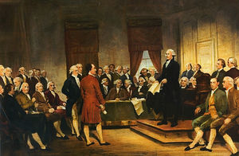

Slide 72
Resources
http://www.constitutionfacts.com

